Slide 1
Game Development
SEN-305
Fall 2023

Slide 2
Course Outcomes
Students be able to understand basic concepts of game Development
Get Knowledge of different Game styles.
Be able to make a Game Design, implement & develop Game with the help of Unity 3D

Slide 3
Assessment Activity Calendar
S.No. | Assessment Activity | Activity Date | Activity Marks | Topics
1 | Assignment-1 | 4th Week | 2.5 | History of Video Games
2 | Quiz-1 | 6th week | 5 | Story and Character Development,
3 | Midterm | 8th week | 30 | All Topics from Quiz-1 and Assignment-1
4 | Assignment-2 | 13th week | 2.5 | Level Design
5 | Quiz-2 | 14th week | 5 | All Topics Covered After Midterm
6 | Presentations | 15th week | 5 | Topics Covered in Semester
7 | FINAL EXAM | 17th week | 50 | All Topics Studied in Semester
 | TOTAL MARKS |  | 100

Slide 4
Course Outline
Introduction to Game Development
History of Video Games
Introduction of Unity 3D
Platform, Players, Genres
Player Elements
Story and Character Development
Gameplay: Rules to Play, Interactivity Modes, Game theory, Challenges, Balance
Animation, Rendering , Audio
Business Side of Game Development, Production and Management
Game Documentation

Slide 5
Introduction
Video game development is the process of creating a video game. Development is undertaken by a game developer, which may range from a single person to a large business
A game played by electronically manipulating images produced by a computer program on a television screen or other display screen is called Video Game.

Slide 6
Difference from movies & Software
Game as an interactive medium
• Difference from movies and other art forms: interactivity
• Difference from software: content of the game as a medium
• More fun

Slide 7
Game Have Got All

Slide 8
Game Structure
Startup
Introductory movie
Front End
Game Options
Sound & Video Options
Loading Screen

Slide 9
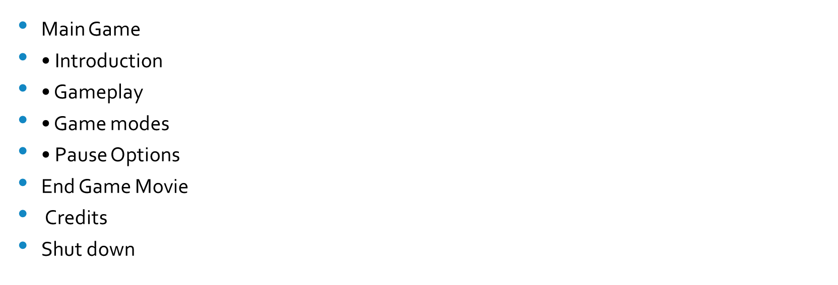
Game Structure Cont.

Slide 10
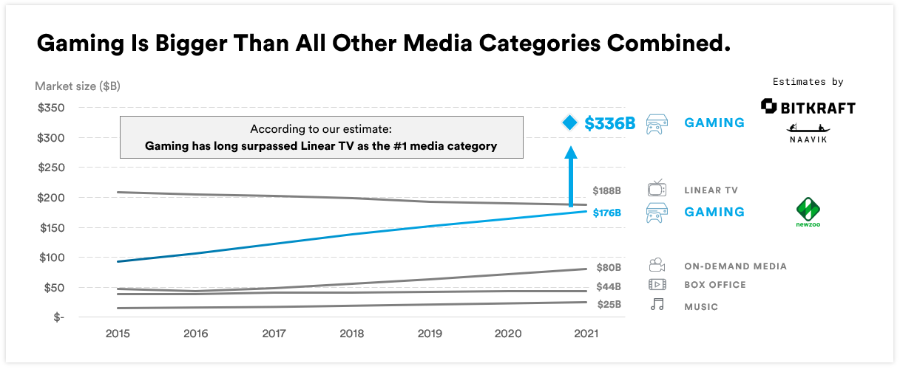
Media Market

Slide 11
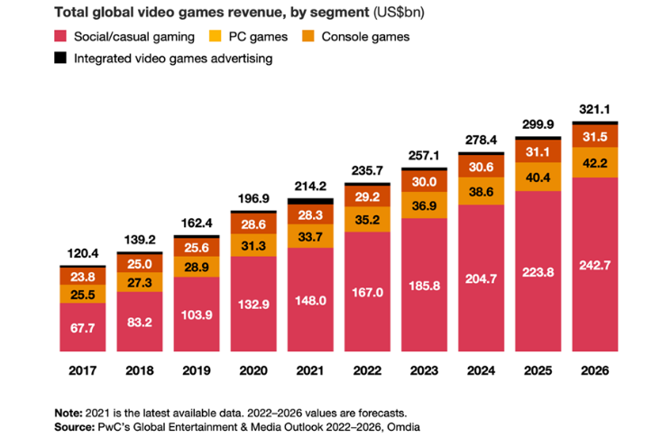

Slide 12
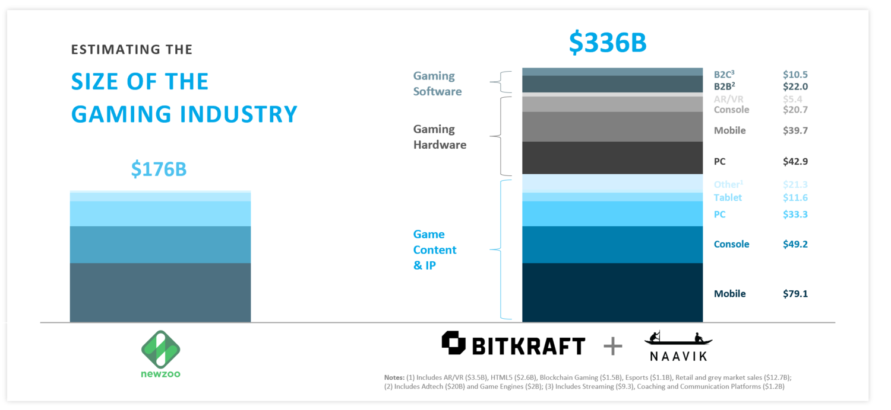

Slide 13
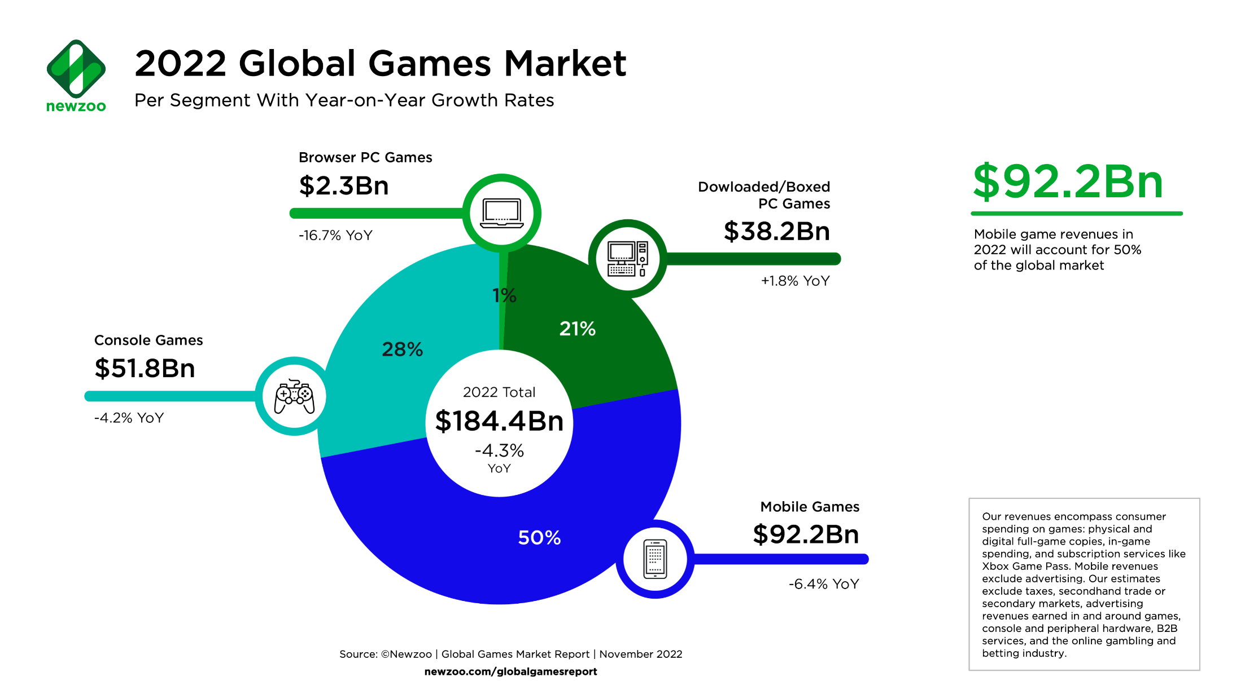
Per Device Market

Slide 14
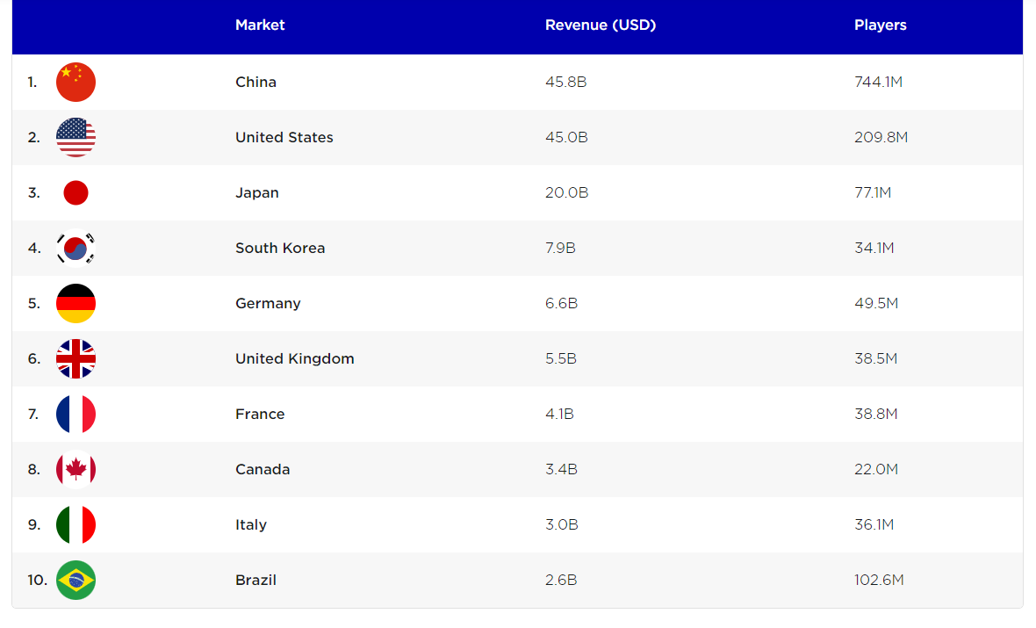
Top 10 countries 2022

Slide 15
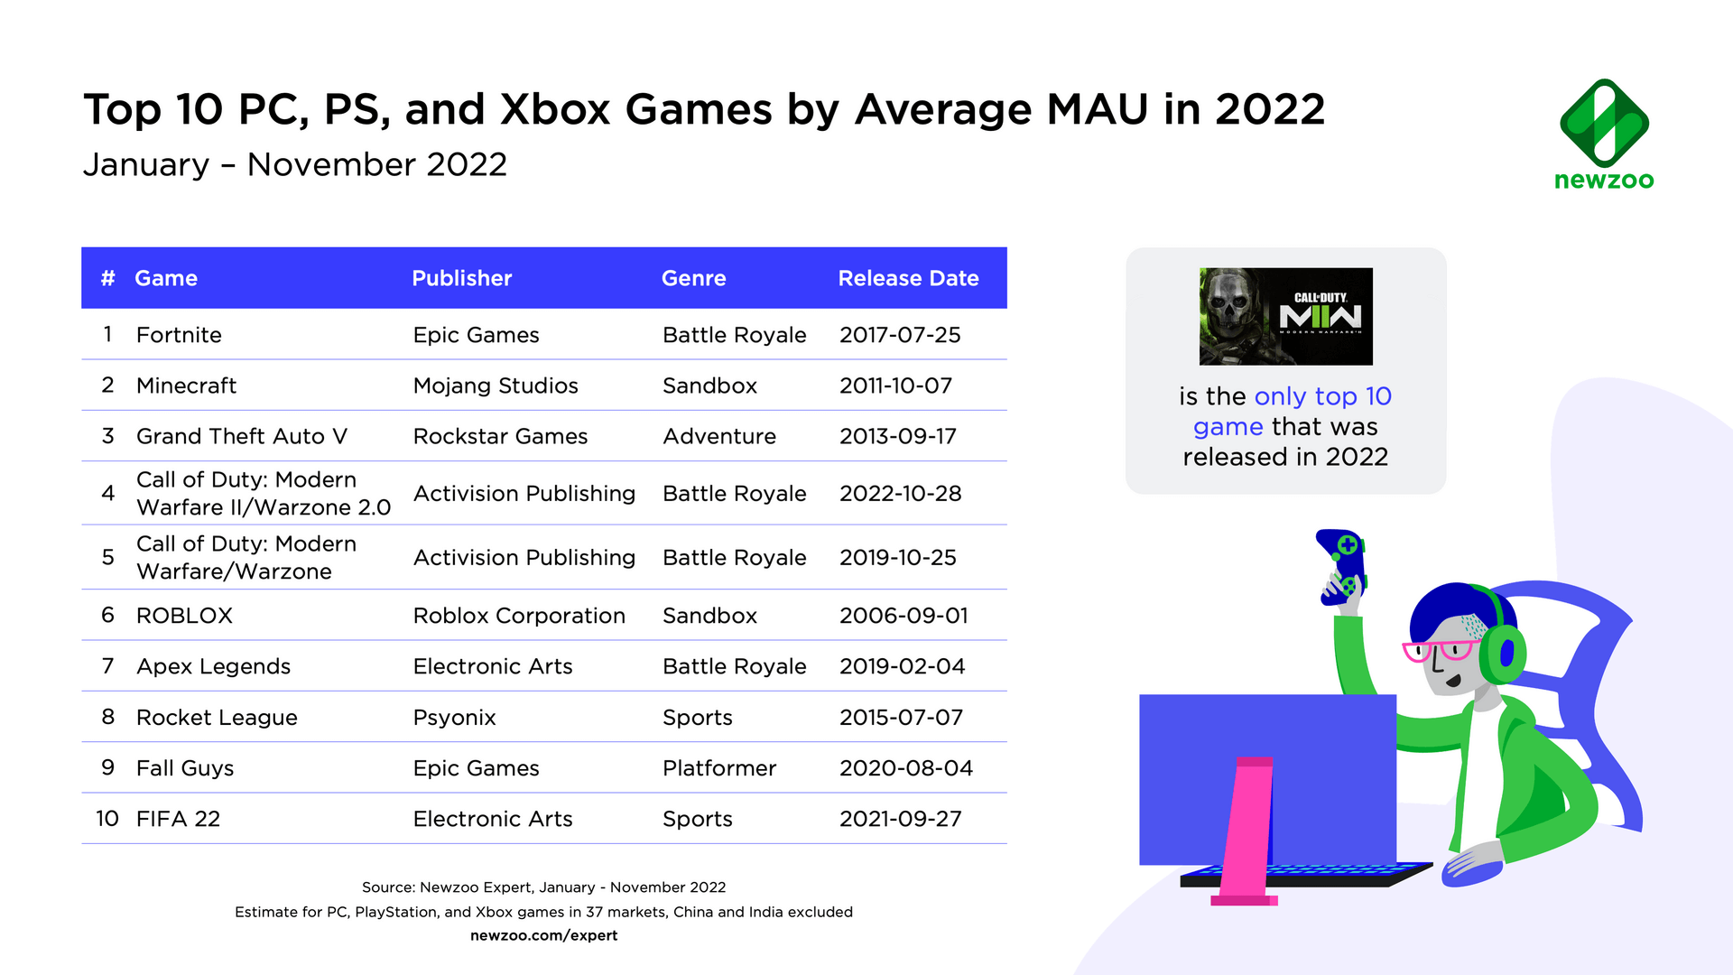
Top Games 2022 according to MAU

Slide 17
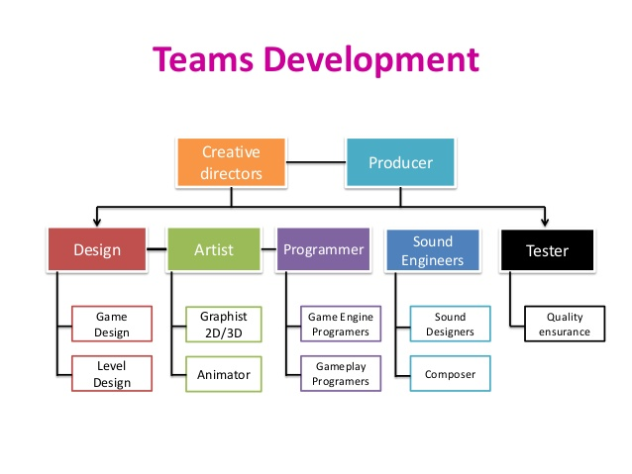

Slide 18
THANKYOU & Questions

